Slide 1
Contract Monthly Claim System
Katlego Mothapo
ST10442760
PROG6212 Poe Part 3

Slide 2
Project Overview
Brief recap of the system's purpose.
Problem it solves: Manual, error-prone claim processing.
Key Stakeholders: Lecturers, Coordinators, Managers, HR.

Slide 3
System Architecture & Technology Stack
Diagram: Simple 3-tier architecture (Presentation -> Application -> Data).
Technologies Used:
  Back-end: C#, ASP.NET Core MVC
  Front-end: HTML, CSS, JavaScript, jQuery
  Data: Entity Framework Core, SQL Server
  Security: ASP.NET Identity

Slide 4
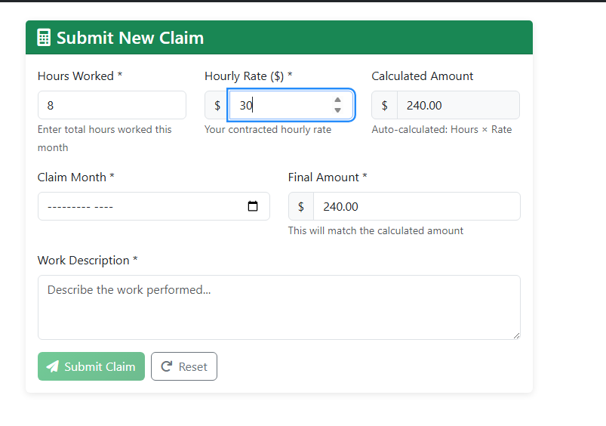
Enhanced Lecturer Experience
Feature 1: Auto-Calculation

Slide 5
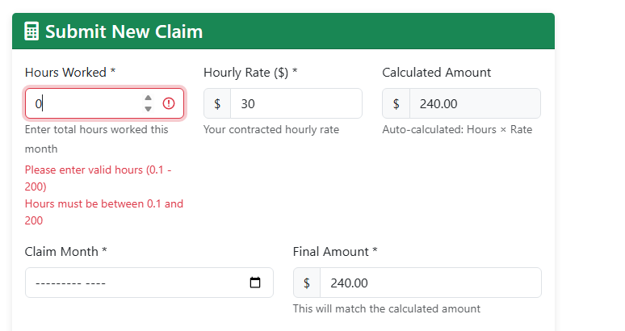
Feature 2: Input Validation

Slide 6
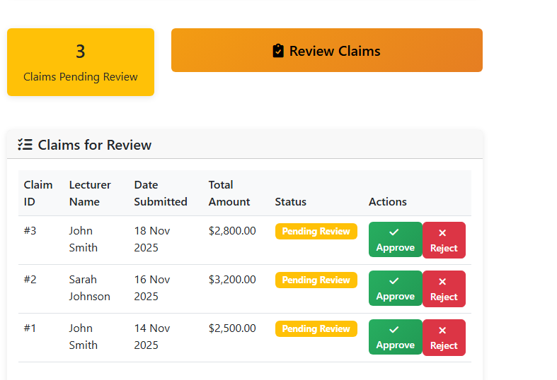
Streamlined Approval Workflow (Automation Demo)
Feature 1: Centralized Dashboard

Slide 7
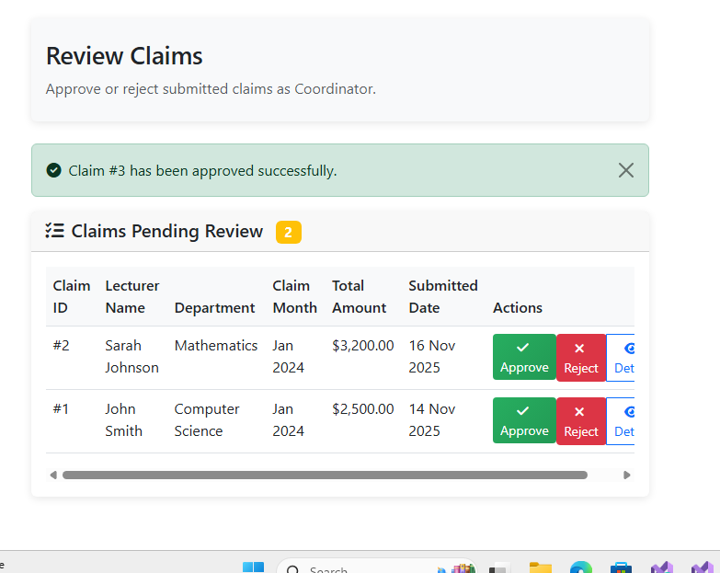
One-Click Approval/Rejection

Slide 8
Feature 3: Automated Policy Checks
The system automatically flags claims that exceed 160 hours through these mechanisms:
Real-time Verification: When a claim is submitted, the code immediately checks if hours exceed 160
Visual Indicators:
  Red exclamation triangle icon next to hours over 160
  Yellow highlighted table rows for flagged claims
  Warning badges and messages
Automatic Flagging: Claims with >160 hours are marked.
Coordinator Alerts: Coordinators see immediate warnings in the review interface
Policy Enforcement: Prevents processing of claims that violate business rules

Slide 9
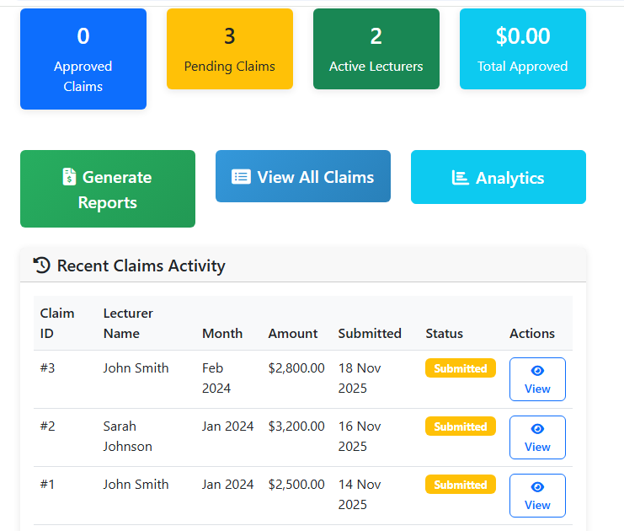
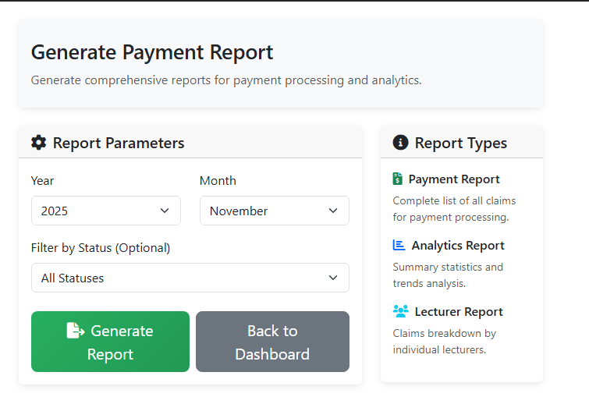
HR Efficiency Tools
On-Demand Reporting

Slide 10
Benefits & Value Proposition
For Lecturers: Faster submission, immediate feedback, transparency.
For Coordinators/Managers: Efficient review, reduced errors, audit trail.
For HR: Automated reporting, streamlined payment processing, centralized data.
Overall: Increased efficiency, cost savings, and improved accuracy.

Slide 11
Future Enhancements
Future Ideas:
  Email notifications for status changes.
  Digital signatures.
  Integration with financial software.
  More advanced analytics dashboards.

